Slide 1
Chapter 7
Efficiency, Exchange, and the Invisible Hand in Action
© 2019 McGraw-Hill Education. All rights reserved. Authorized only for instructor use in the classroom. No reproduction or distribution without the prior written consent of McGraw-Hill Education.

Slide 2
Learning Objectives
Define and explain the differences between accounting profit, economic profit, and normal profit.
Explain the Invisible Hand Theory and show how economic profit and economic loss affect the allocation of resources across industries.
Explain why economic profit, unlike economic rent, tends toward zero in the long run.
Identify whether the market equilibrium is socially efficient, and explain why no opportunities for gain remain open for individuals when a market is in equilibrium.
Calculate total economic surplus and explain how it is affected by policies that prevent the market from reaching equilibrium.

Slide 3
Markets Are Dynamic
Every time you see one of these signs, you see the market dynamics at work:
Store for Lease
Going Out of Business Sale
Everything Must Go
Now Open
Close-Out Model
Under New Management

Slide 4
The Invisible Hand
Individuals act in their own interests
Aggregate outcome is collective well-being
Profit motive
Produces highly valued goods and services
Allocates resources to their highest value use
Lebron James does not wait tables

Slide 5
Accounting Profit
Most common profit idea
Accounting profit = total revenue − explicit costs
Explicit costs are payments firms make to purchase
Resources (labor, land, etc.) and
Products from other firms
Easy to compute
Easy to compare across firms

Slide 6
Economic Profit
Economic profit is the difference between a firm's total revenue and the sum of its explicit and implicit costs
Also called excess profits
Implicit costs are the opportunity costs of the resources supplied by the firm's owners
Normal profit is the difference between accounting profit and economic profit
Normal profits keep the resources in their current use

Slide 7
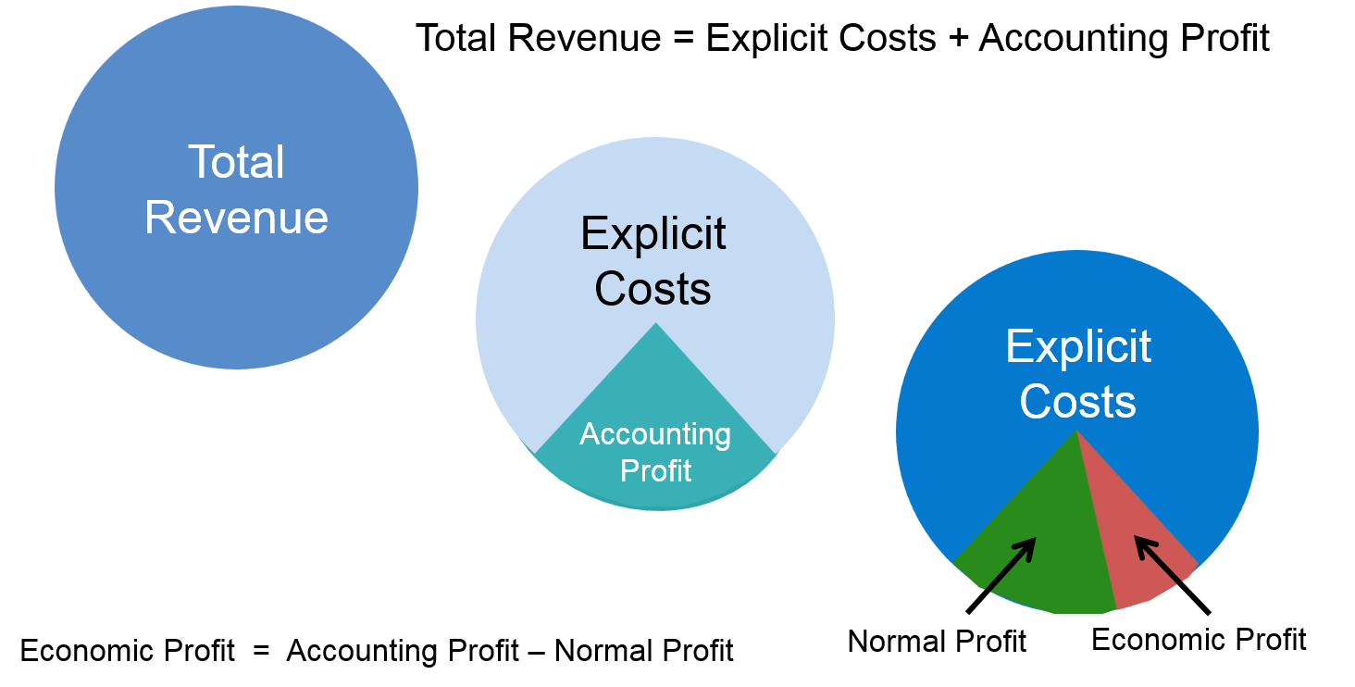
Three Kinds of Profit

Slide 8
Example: Economic Profit Guides Decisions
Pudge Buffet's decision: continue farming or quit?
Quit farming and earn $11,000 per year working retail
Explicit farm costs are $10,000
Total revenue is $22,000
Accounting Profit | Economic Profit | Normal Profit
$12,000 | $1,000 | $11,000
Pudge should stick with farming
His economic profit is positive

Slide 9
Example: Economic Profit Guides Decisions, A Change in Revenue
Pudge Buffet's decision: continue farming or quit?
Quit farming and earn $11,000 per year working retail
Explicit farm costs are $10,000
Total revenue is $20,000
Accounting Profit | Economic Profit | Normal Profit
$10,000 | −$1,000 | $11,000
Pudge should quit
His economic profit is negative

Slide 10
Example: Owned Inputs
Rent for the farm land is $6,000 of the $10,000 in explicit costs
What changes if Pudge inherits the land?
His rent payments become an implicit cost
Total Revenue | Explicit Costs | Implicit Costs
$20,000 | $4,000 | $17,000
Accounting Profit | Economic Profit | Normal Profit
$16,000 | −$1,000 | $17,000
Pudge should quit farming

Slide 11
Two Functions of Price
Rationing function of price distributes scarce goods to the consumers who value them most highly
Allocative function of price directs resources away from overcrowded markets to markets that are underserved
Invisible Hand Theory states that the actions of independent, self-interested buyers and sellers will often result in the most efficient allocation of resources
Articulated by Adam Smith in eighteenth century

Slide 12
Responses to Profits and Losses
Will the firm remain in business in the long run?
If it covers ALL of its costs
Firms that earn normal profit recover only their opportunity cost
Firms that earn positive economic profit recover more than their opportunity cost
Markets in which firms are earning economic profit will attract resources
Markets in which firms are suffering economic losses will lose resources

Slide 13
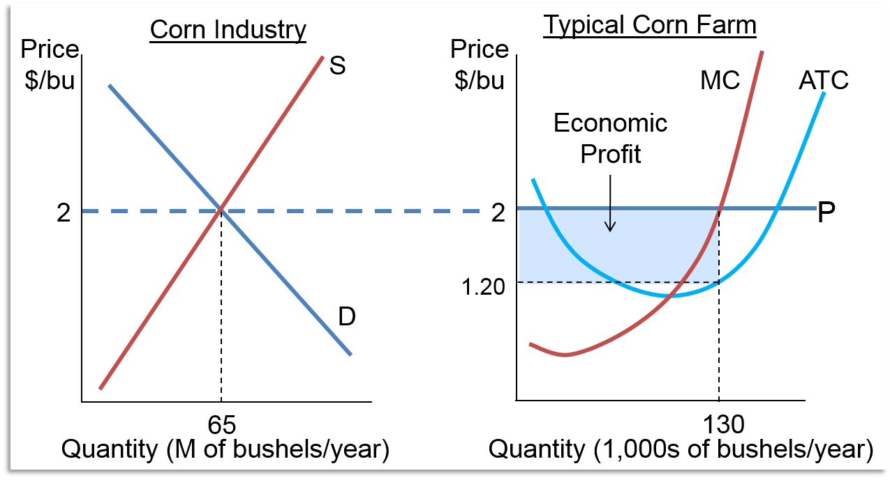
Response to Economic Profits
Markets with excess profits attract resources
Access the text alternative for these images

Slide 14
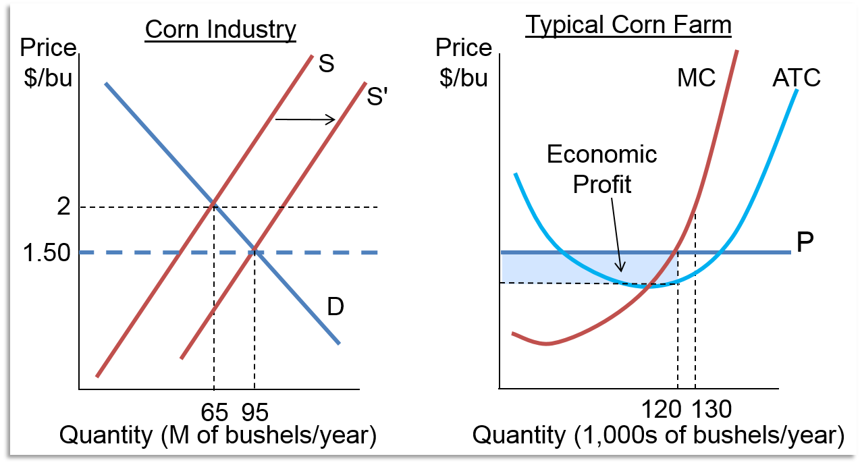
Shrinking Economic Profits
Supply increases
Access the text alternative for these images

Slide 15
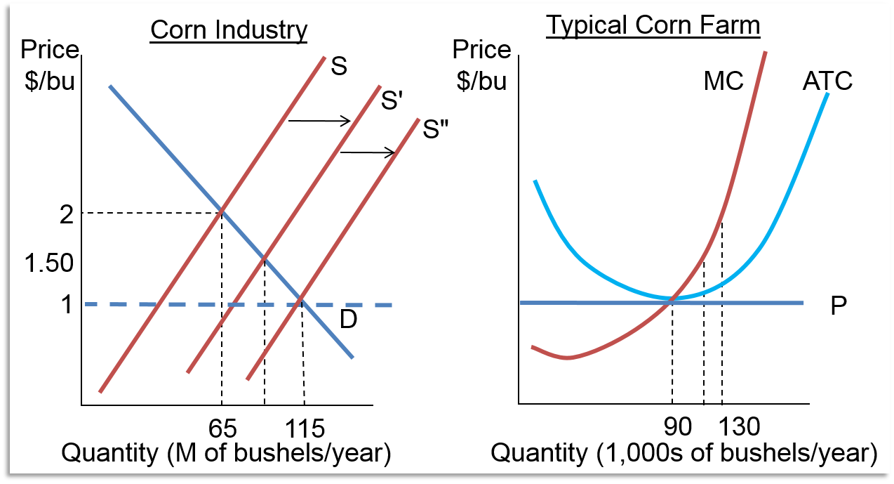
Market Equilibrium 1
Zero economic profits
Access the text alternative for these images

Slide 16
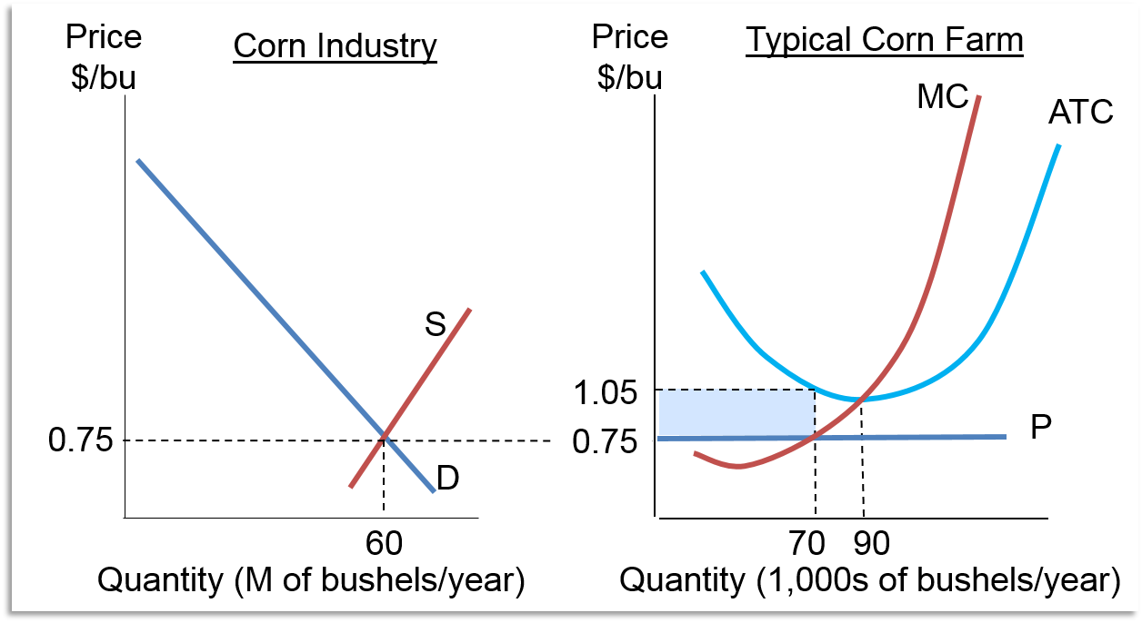
Economic Losses
Resources leave
Access the text alternative for these images

Slide 17
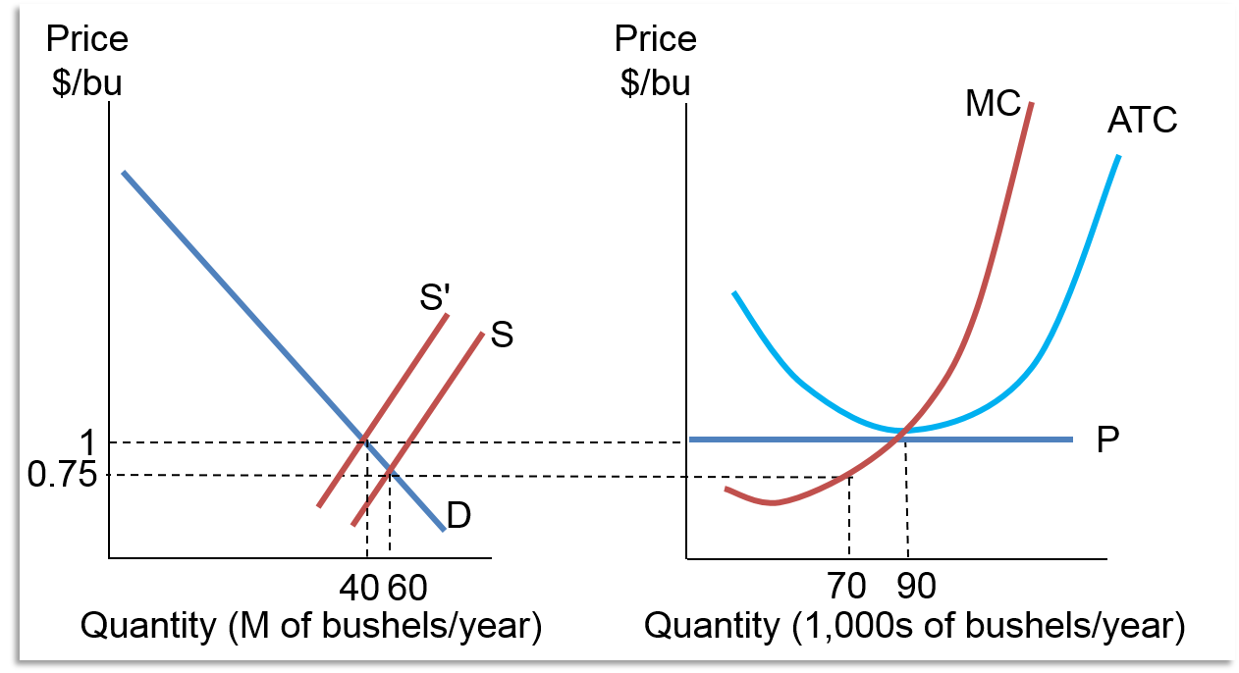
Market Equilibrium 2
No economic losses
Access the text alternative for these images

Slide 18
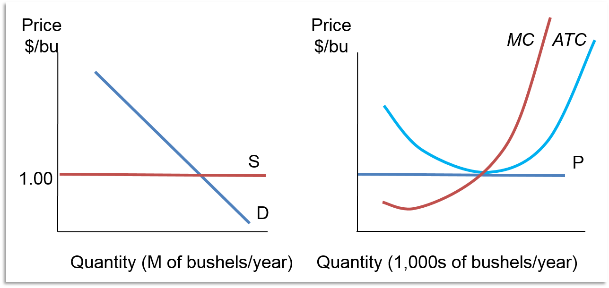
Constant-Cost Industry
In the long run, corn costs $1/bu regardless of the size of the industry
Access the text alternative for these images

Slide 19
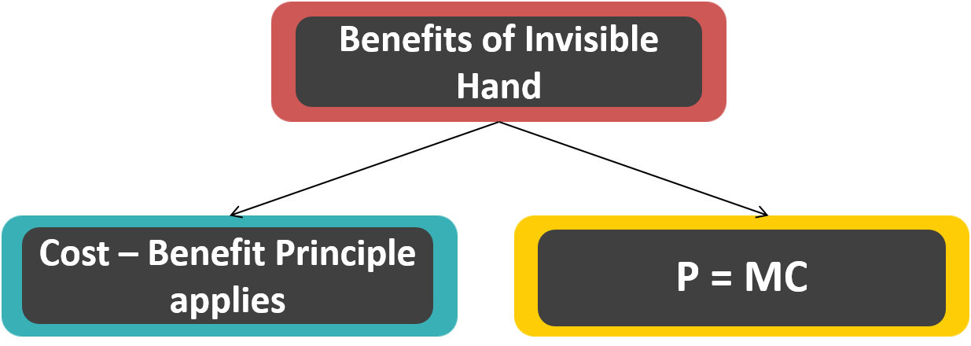
Features of the Invisible Hand

Slide 20
Example: Movement Toward Equilibrium
Imagine haircut and Pilates markets are in equilibrium (long run) and then demand for haircuts drops, and demand for exercise increases
All markets are in equilibrium when
Demand for haircuts decreases
Demand for exercise increases
Price of haircuts goes down; hair stylists have losses
Price of aerobics classes go up; instructors have excess profits
Eventually the long-run prices of haircuts and aerobics class return to long-run equilibrium

Slide 21
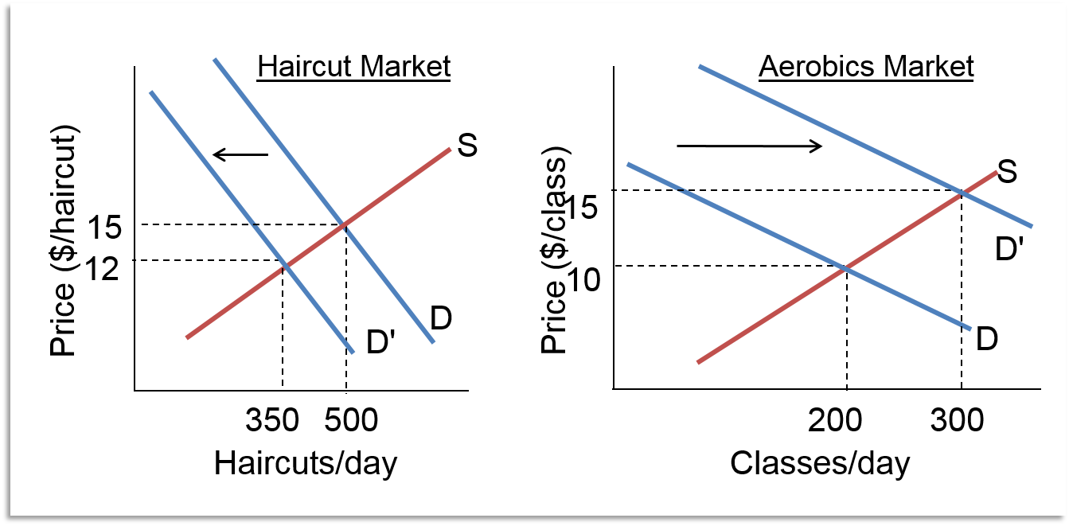
Short-Run Adjustments 1
Access the text alternative for these images

Slide 22
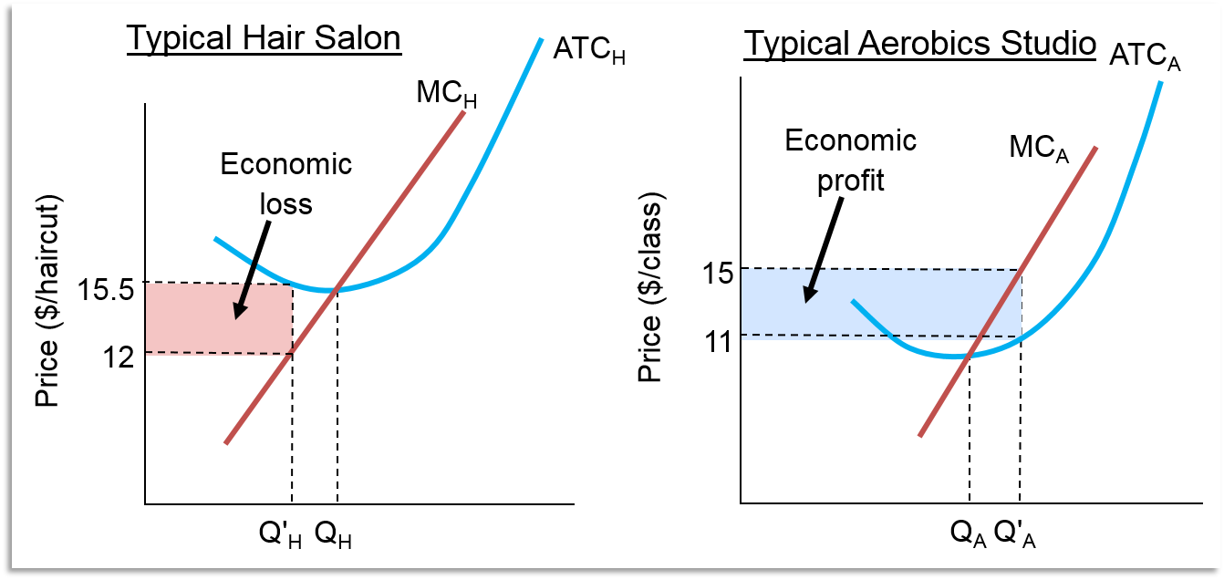
Short-Run Adjustments 2
Access the text alternative for these images

Slide 23
Free Entry and Exit
Barrier to entry: any force that prevents firms from entering a new industry
Legal constraints
Practical factors
Free entry and exit is required for the Invisible Hand to work

Slide 24
Economic Rent
Economic profits tend toward zero, yet people get rich
Economic rent is the portion of a payment to a factor of production that exceeds the owner's reservation price
People who love their work
Non-reproducible input
The case of the talented chef
Unique talent for cooking
In equilibrium, pay the chef the increase in revenue from his talent

Slide 25
Invisible Hand in the Supermarket
No Cash on the Table Principle says short check-out lines get longer – quickly
Information is freely available
Start in the shortest line
Observe the pace of all lines
Missing price in your line
Complaining customer next to you
Decide whether to switch

Slide 26
Invisible Hand and Cost-Saving Innovations
Competitive firms are price takers
Cost management required
Innovation lowers cost for one firm
Profits increase by amount of cost savings
Information is freely available
Industry costs decrease
Equilibrium price decreases by amount of cost savings
No excess profit

Slide 27
Example: Shipping Innovation
40 companies compete in trans-Atlantic shipping
Cost per trip is $500,000
One firm innovates to save $20,000 in fuel per trip
Short-run economic profit
Over time, competitors copy the innovation
Industry costs decrease by $20,000
Equilibrium price decreases by $20,000
In the long run, no firm earns economic profit

Slide 28
Market Equilibrium and Big Payoffs
Equilibrium leaves no opportunities for individuals to gain
Non-equilibrium opportunities benefit individuals
Exploiting opportunities moves the market towards equilibrium
Three ways to earn a big payoff:
Work exceptionally hard
Have some unique skill or talent
Be lucky

Slide 29
Invisible Hand and Socially Optimal Outcome
Markets work best when
Buyers' marginal benefits = sellers' marginal costs
AND
Society's marginal benefits = society's marginal costs
Individual spending to improve a stock price forecast may benefit the individual
Some other individual loses
Return to society of the investment is less than the benefit

Slide 30
Market Equilibrium and Efficiency
Economic efficiency exists when no change could be made to benefit one party without harming the other
Sometimes called Pareto efficiency
Different from engineering efficiency
Equilibrium price and quantity are efficient
Prices above or below equilibrium are not

Slide 31
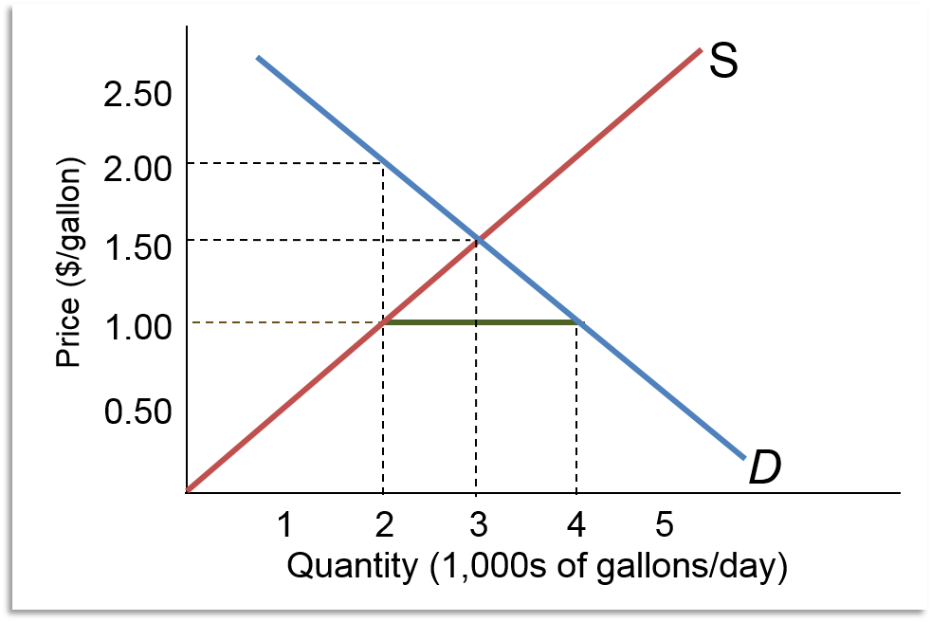
Price Below Equilibrium 1
Suppose milk is $1 per gallon

Slide 32
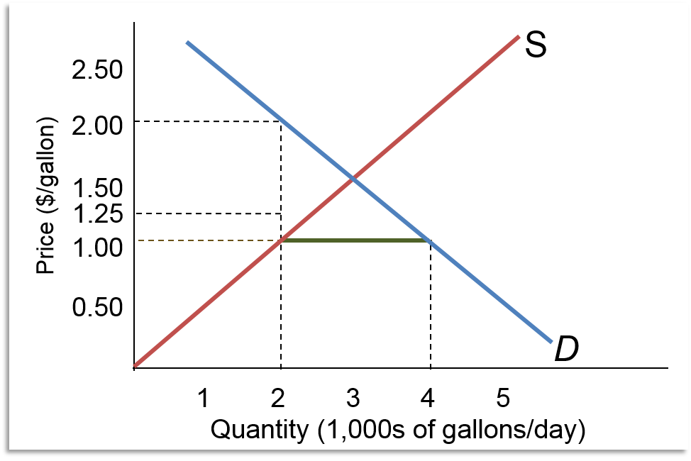
Price Below Equilibrium 2
A buyer offers $1.25
There’s a seller who would happily take that price!

Slide 33
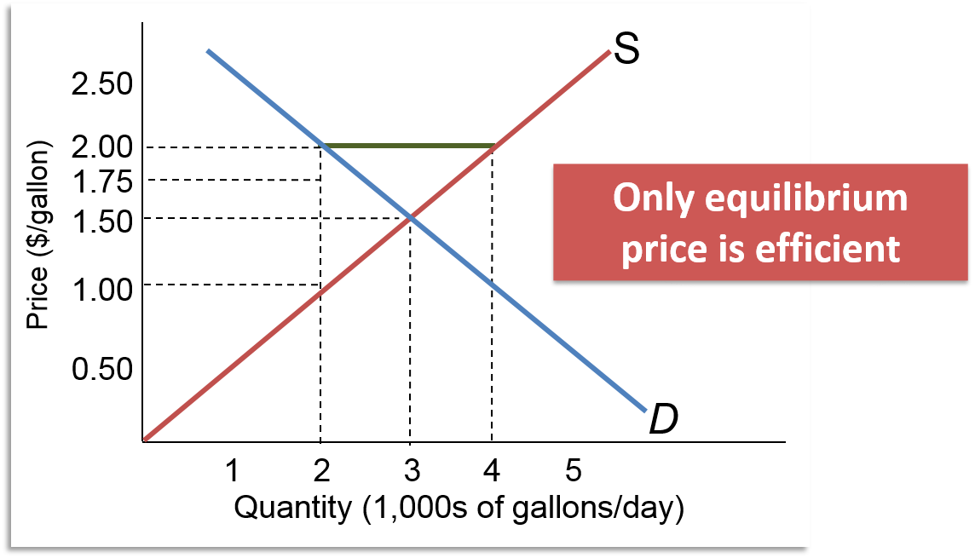
Price above Equilibrium

Slide 34
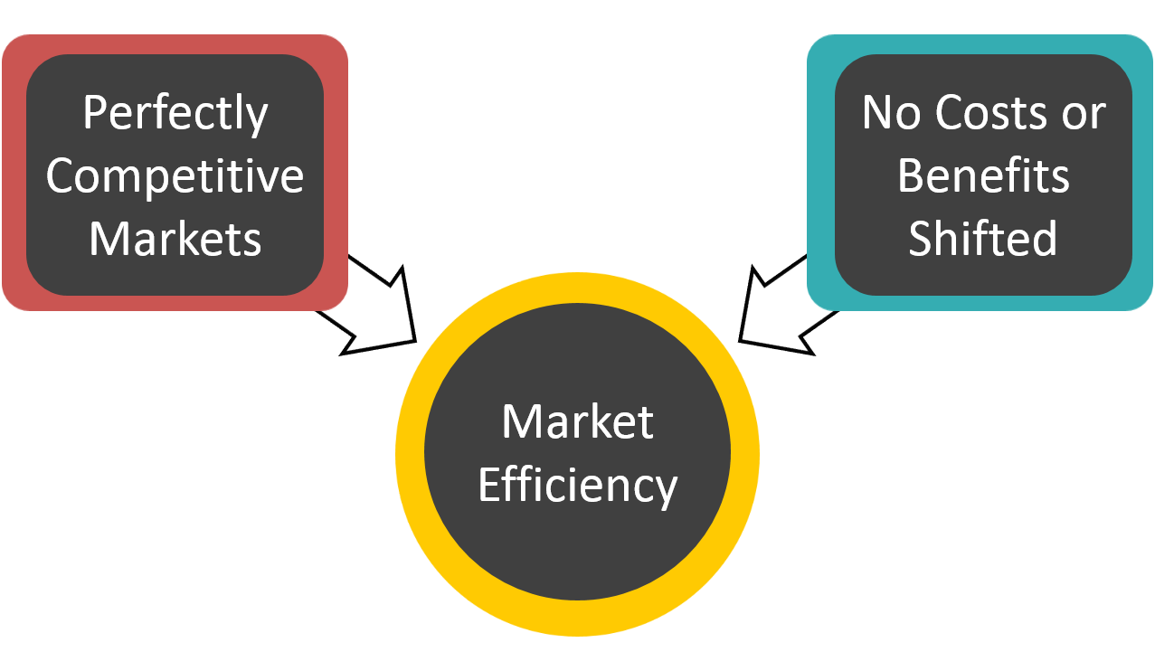
Efficiency Conditions

Slide 35
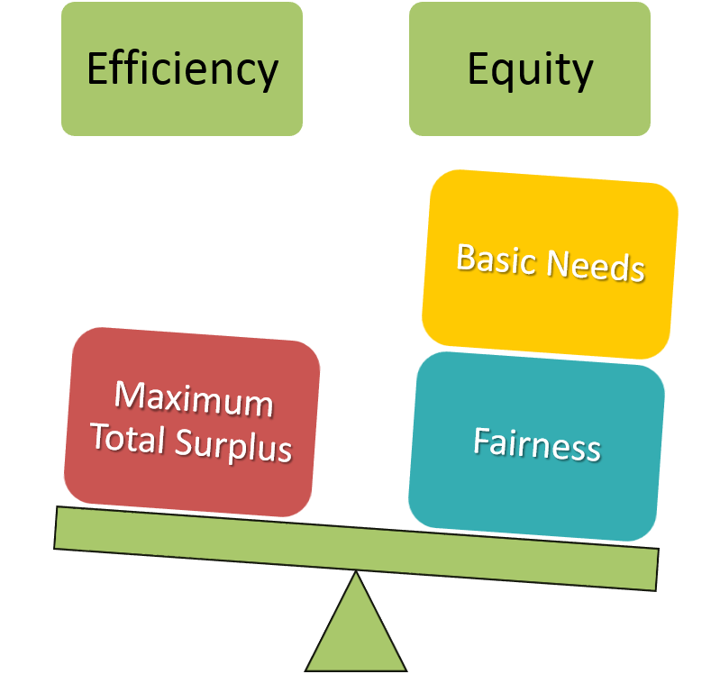
Trade-Offs

Slide 36
The Cost of Preventing Price Adjustments
Price ceilings
A maximum allowable price, specified by law
Price subsidies
Meant to assist low-income consumers, governmental funding of “essential” goods and services

Slide 37
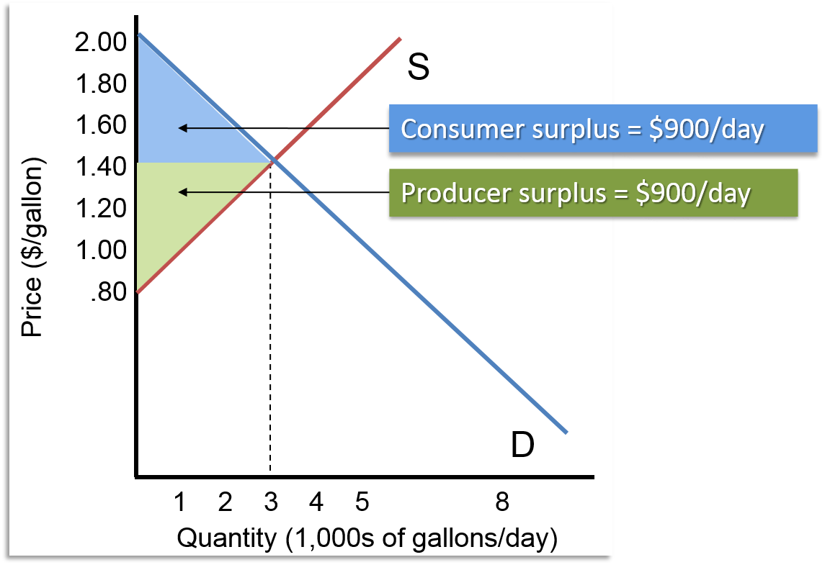
Example: Heating Oil Market
Access the text alternative for these images

Slide 38
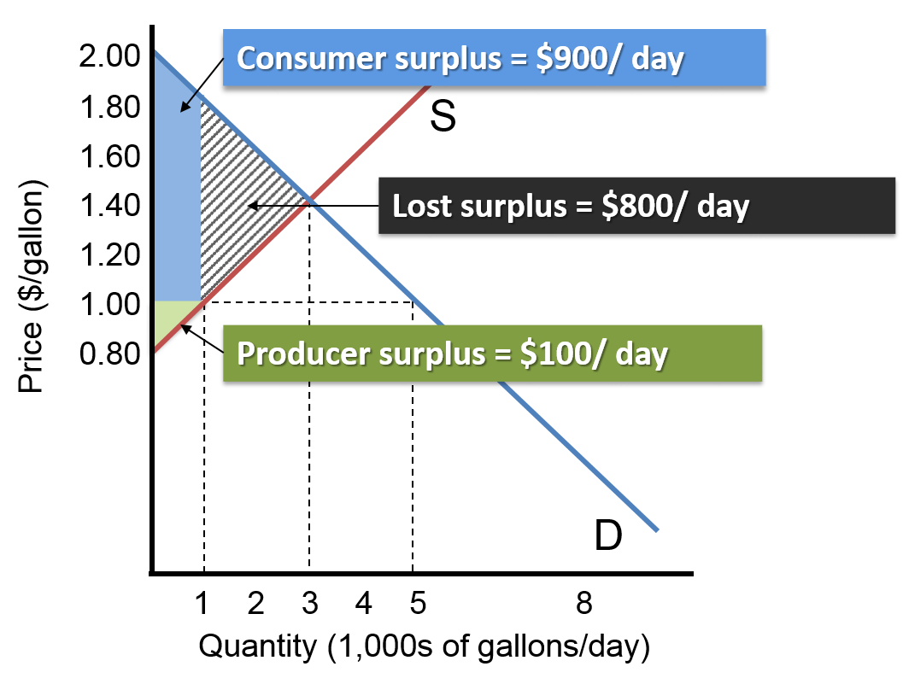
Price Ceiling on Heating Oil
Access the text alternative for these images

Slide 39
Surplus Lost to a Price Ceiling
$800 underestimates surplus loss
Consumers place different values on heating oil
If a person with a lower reservation price gets the oil, there is additional surplus lost
Shortages increase non-market costs
Waiting in line
Side payments

Slide 40
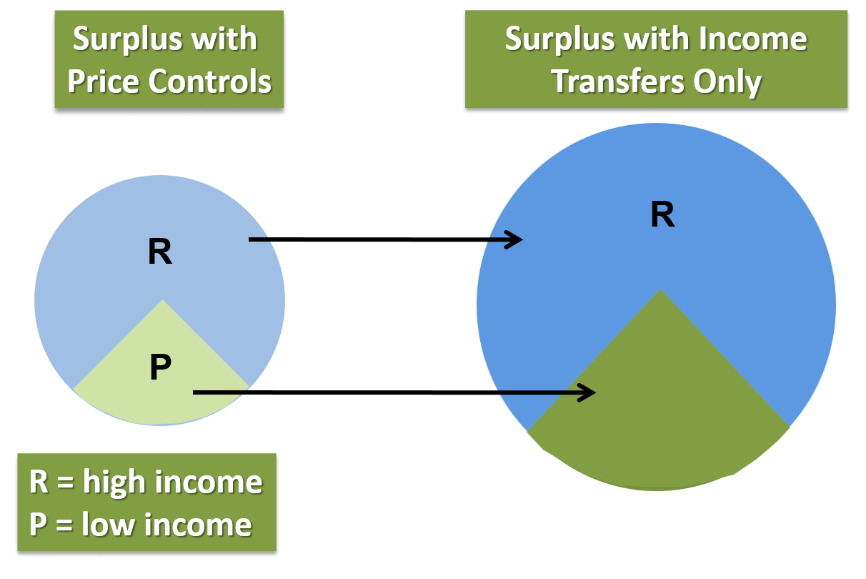
Alternative Heating Oil Policy

Slide 41
Example: Price Subsidy for Bread
Imported bread costs $2
Perfectly elastic supply
Government program to subsidize bread
Government imports bread for $2
Government sells bread for $1
Results
More bread
Less efficiency

Slide 42
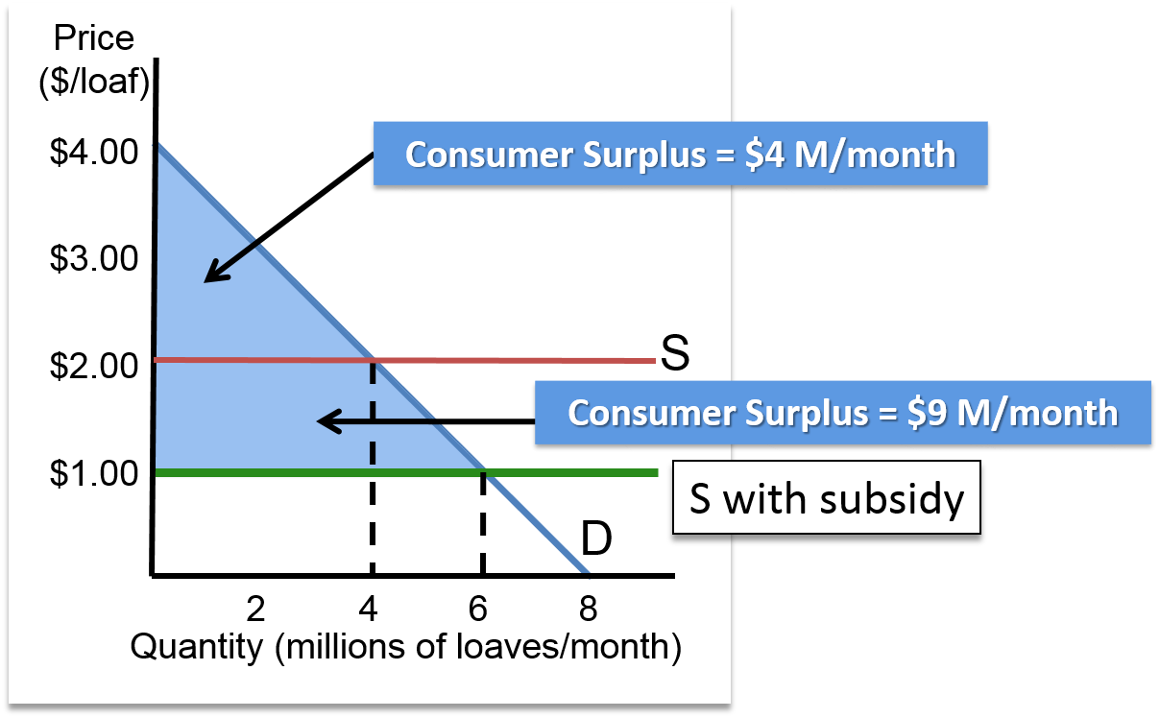
Price Subsidies for Bread 1
Access the text alternative for these images

Slide 43
The Cost of the Subsidy
The bread subsidy appears to increase consumer surplus from $4 million to $9 million
BUT …
The government loses $1 on every loaf
Imports 6 million loaves for $2 per loaf
Government losses are $6 million
The net benefit of the subsidy program
Consumer surplus – government losses
Net benefit = $3 million

Slide 44
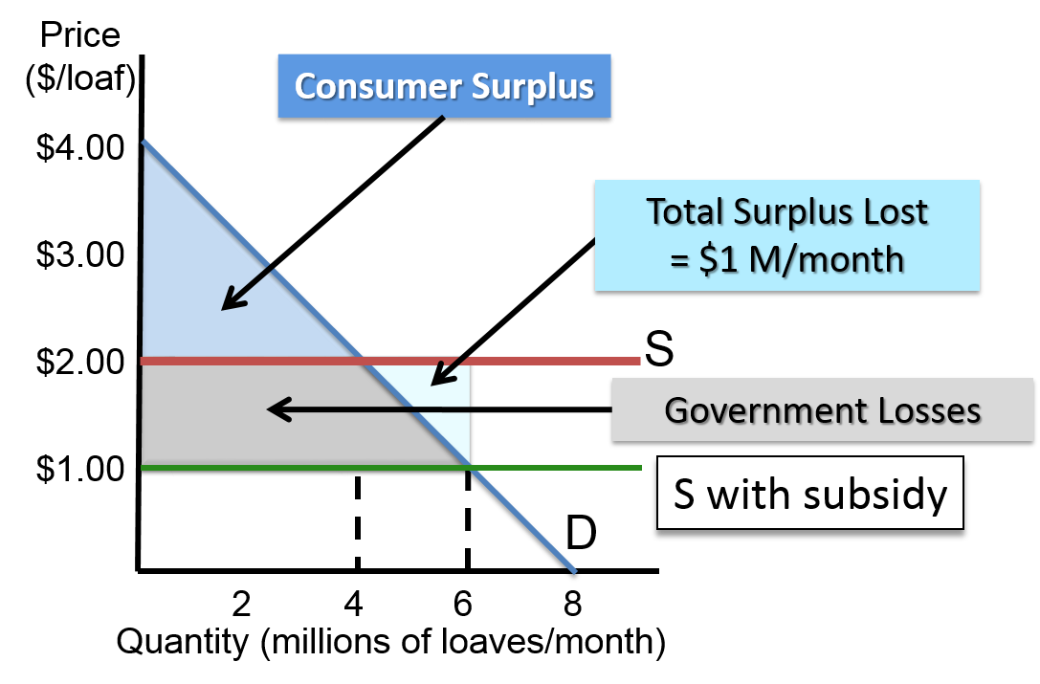
Price Subsidies for Bread 2

Slide 45
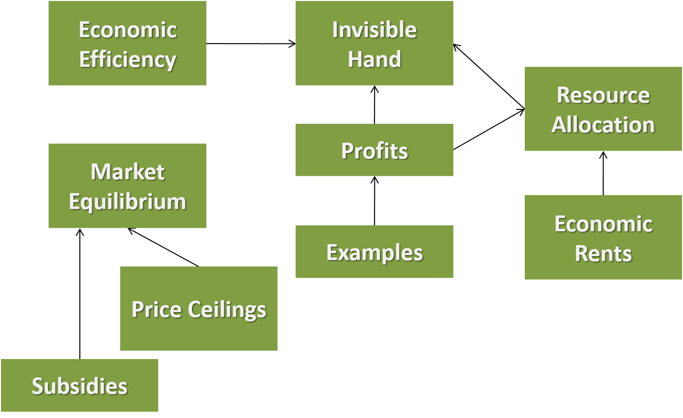
Invisible Hand in Action

Slide 46
Accessibility Content: Text Alternatives for Images

Slide 47
Response to Economic Profits Text Alternative
The first graph (a) shows the demand curve, D, with a downward slope and the supply curve, S, with an upward slope. The supply and demand curves intersect at (65, 2.00). The second graph (b) shows the average total cost curve, ATC, as a u-shaped curve that intersects point (130, 1.20) at the right side of the curve. The marginal cost curve, MC, originates below the ATC curve then slopes upward intersecting the ATC curve and point (130, 2.00). The rectangular area from Price= 1.20 to 2.00 over to Quantity=130 is shaded and labeled Economic profit = $104,000/year.
Return to slide containing original image

Slide 48
Shrinking Economic Profits Text Alternative
The first graph (a) shows the demand curve, D, with a downward slope and the supply curve, S, with an upward slope. The supply and demand curves intersect at (65, 2.00). The new supply curve, S1, shifts to the right and intersects the demand curve at (95, 1.50). The second graph (b) shows the average total cost curve, ATC, as a u-shaped curve that intersects point (120, 1.08) at the bottom of the curve. The marginal cost curve, MC, originates below the ATC curve then slopes upward intersecting the ATC curve and point (130, 2.00). The horizontal Price line at 1.50 intersects the ATC curve twice and the MC curve at (120, 1.50). The rectangular area from below the Price line at 1.50 down to 1.08 over to Quantity=120 is shaded and labeled Economic profit = $50,400/year.
Return to slide containing original image

Slide 49
Market Equilibrium 1 Text Alternative
The first graph (a) shows the demand curve, D, with a downward slope and the supply curve, S, with an upward slope. The supply and demand curves intersect at (115, 1.00). The second graph (b) shows the horizontal Price line at 1.00. The average total cost curve, ATC, is a u-shaped curve that intersects the Price line at (90, 1.00) at the bottom of the ATC curve. The marginal cost curve, MC, originates below the ATC curve then slopes upward intersecting the ATC curve and Price line at (90, 1.00).
Return to slide containing original image

Slide 50
Economic Losses Text Alternative
The first graph (a) shows the demand curve, D, with a downward slope and the supply curve, S, with an upward slope. The supply and demand curves intersect at (60, .75). The second graph (b) shows the horizontal Price line at .75. The average total cost curve, ATC, is a u-shaped curve above the Price line with the bottom of the curve at Quantity= 90. The marginal cost curve, MC, originates below the ATC curve and Price line then slopes upward intersecting the Price line at (70, .75) and the ATC curve at Quantity= 90. The rectangular area from above the Price line at .75 up to 1.05 over to Quantity=70 is shaded and labeled Economic loss = $21,000/year.
Return to slide containing original image

Slide 51
Market Equilibrium 2 Text Alternative
The first graph (a) shows the demand curve, D, with a downward slope and the supply curve, S, with an upward slope. The supply and demand curves intersect at (60, .75). The new supply curve, S1, shifts to the left and intersects the demand curve at (40, 1.00). The second graph (b) shows the horizontal Price line at 1.00. The average total cost curve, ATC, is a u-shaped curve that intersects the Price line at (90, 1.00) at the bottom of the ATC curve. The marginal cost curve, MC, originates below the ATC curve then slopes upward intersecting the ATC curve and Price line at (90, 1.00).
Return to slide containing original image

Slide 52
Constant-Cost Industry Text Alternative
The first graph (a) shows the demand curve, D, with a downward slope and the supply curve, S, with an upward slope. The supply and demand curves intersect at (115, LMC=LAC=1.00). The second graph (b) shows the horizontal Price line at 1.00. The average total cost curve, ATC, is a u-shaped curve that intersects the Price line at (90, 1.00) at the bottom of the ATC curve. The marginal cost curve, MC, originates below the ATC curve then slopes upward intersecting the ATC curve and Price line at (90, 1.00).
Return to slide containing original image

Slide 53
Short-Run Adjustments 1 Text Alternative
The first graph (a) shows the demand curve, D, with a downward slope and the supply curve, S, with an upward slope. The supply and demand curves intersect at (500, 15). The demand curve shifts to the left, D1, and intersects the supply curve at (350, 12). The second graph (b) shows the demand curve, D, with a downward slope and the supply curve, S, with an upward slope. The supply and demand curves intersect at (200, 10). The demand curve, D1, shifts to the right and intersects the supply curve at (300, 15).
Return to slide containing original image

Slide 54
Short-Run Adjustments 2 Text Alternative
The first graph (a) shows the ATCH curve as a u-shaped curve and the MCH curve with an upward slope that intersects the ATCH curve at (QH, 15.50). The rectangular area on the graph from Price=15.50 to 12 over to the MCH curve below the ATCH curve at Q1H is shaded and labeled Economic loss. The second graph (b) shows the ATCA curve as a u-shaped curve and the MCA curve with an upward slope that intersects the ATCH curve at (QA, 11). The rectangular area on the graph from Price=15 to 12 past the MCH curve to the ATCH curve at Q1A is shaded and labeled Economic profit.
Return to slide containing original image

Slide 55
Example: Heating Oil Market Text Alternative
The graph shows the demand curve, D, with a downward slope and the supply curve, S, with an upward slope. The supply curve originates at (0, .80), the demand curves originates at (0, 2.00), and they intersect at (3, 1.40). The triangular area above Price=$1.40 over to the demand curve is shaded and labeled Consumer surplus = $900/day. The triangular area below Price=$1.40 over to the supply curve is shaded and labeled Producer surplus = $900/day.
Return to slide containing original image

Slide 56
Price Ceiling on Heating Oil Text Alternative
The graph shows the demand curve, D, with a downward slope and the supply curve, S, with an upward slope. The supply curve originates at (0, .80), the demand curves originates at (0, 2.00), and they intersect at (3, 1.40). The area from Price=$1.00 to $2.00 over to Quantity=1 is shaded and labeled Consumer surplus = $900/day. The triangular area below Price=$1.00 to .80 over to the supply curve is shaded and labeled Producer surplus = $100/day. The triangular area between the supply and demand curve from Quantity=1 to 3 is shaded and labeled Lost economic surplus = $800/day.
Return to slide containing original image

Slide 57
Price Subsidies for Bread 1 Text Alternative
The graph shows the demand curve, D, with a downward slope and the supply curve, S, as a horizontal line at World price = $2.00. The demand curve originates at (0, 4.00) and it intersects the supply curve at (4, 2.00) before ending at (8. 0). A horizontal line, Domestic price with subsidy, at Price=1.00 intersects demand at (6, 1.00). The triangular area above Domestic price with subsidy at Price=$1.00 up to the demand curve is shaded and labeled Consumer surplus = $9,000,000/month. The triangular area above the demand curve over to Quantity = 6 below the supply curve is shaded and labeled Reduction in total economic surplus = $1,000,000/month.
Return to slide containing original image

